Slide 1
Neuromeka Indy7 Manual
Lee Yongseok, Jung Hyunseo
dldydtjr2000@postech.ac.kr
hsjung02@postech.ac.kr

Slide 2
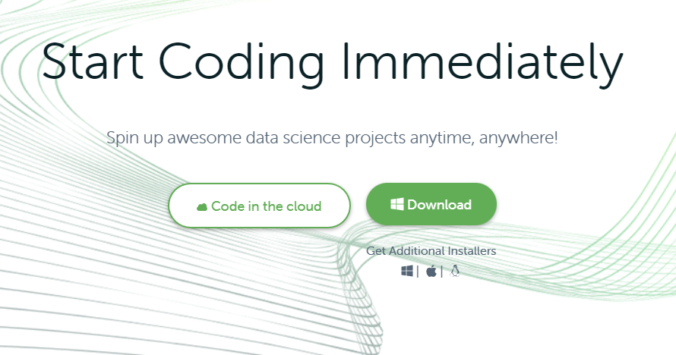
1. Installation
1) Anaconda
① Install anaconda from https://www.anaconda.com/
①

Slide 3
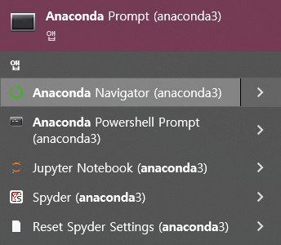
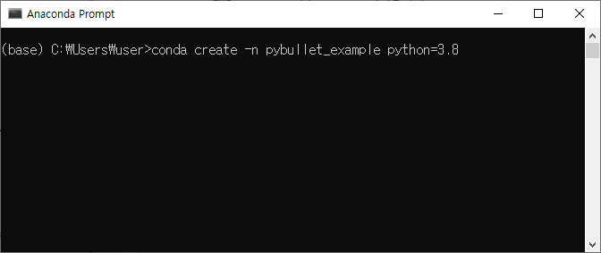
1. Installation
2) Anaconda
② Open anaconda prompt, and create new environment
①
②
>conda create -n [env name] python=3.8

Slide 4
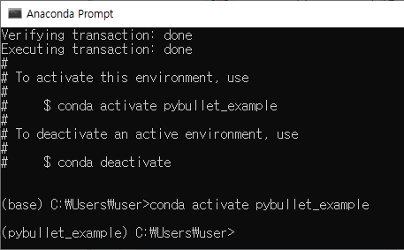
1. Installation
2) Anaconda
② Activate new environment
①
>conda create activate [env name]

Slide 5
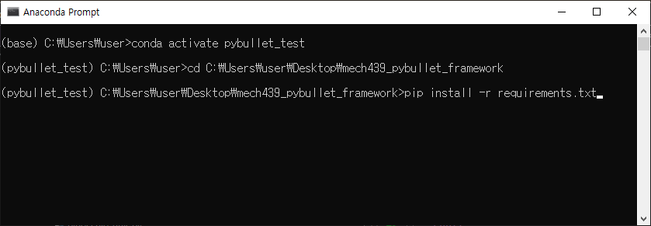
1. Installation
3) Install required packages
① Install the required dependencies via “pip install’’.
> cd [YOUR PATH]
> pip install numpy matplotlib jupyter neuromeka

Slide 6
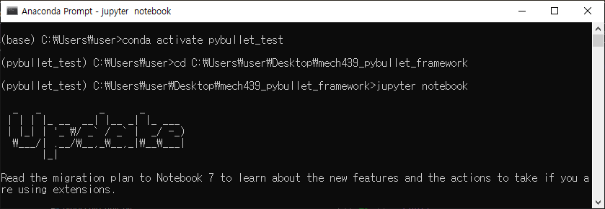
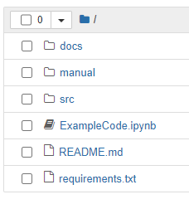
2. Run example code
Jupyter notebook
① Open jupyter notebook in project directory, and open ExampleNRMK_IndyDCP3.ipynb

Slide 7
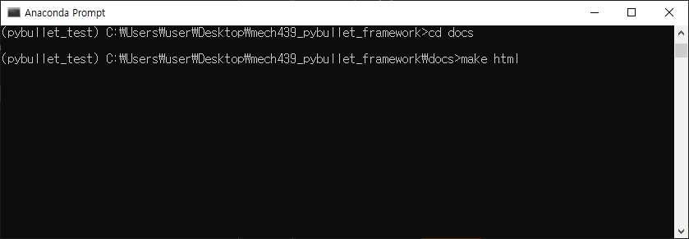
3. Source Code Manual
Build docs (.html) file via sphinx
① Open jupyter notebook in project directory, and open ExampleCode.ipynb
> cd docs
> make html

Slide 8
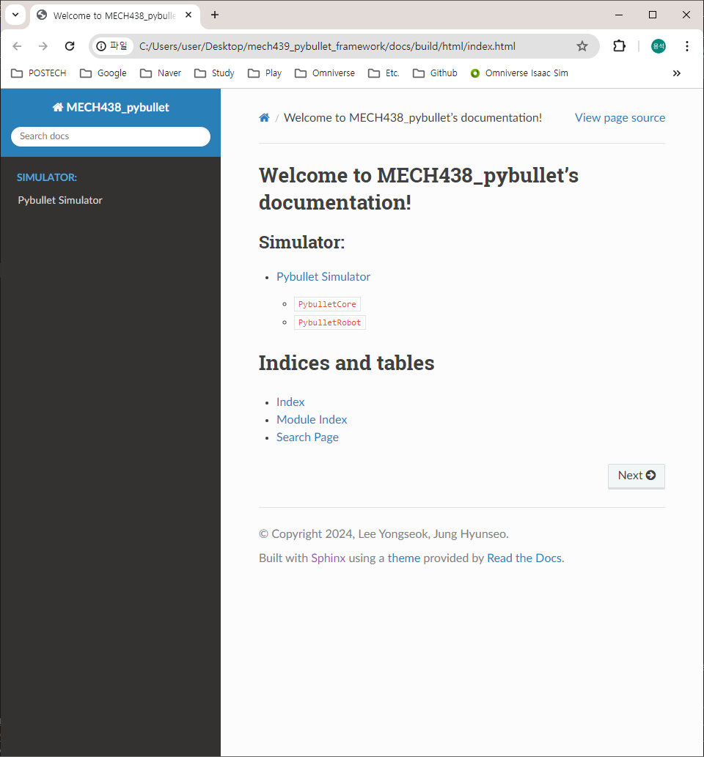
3. Source Code Manual
Build docs (.html) file via sphinx
② Then, you can open the source code manual in “docs/build/html/index.html”

